Slide 1


CANoe PSM implementation
More Lives Saved
More Life Lived
Agapi Grigore
SWV

Slide 2
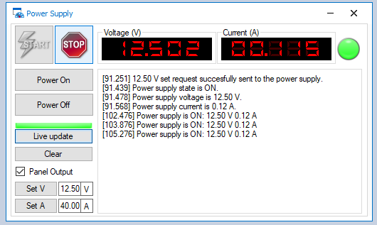
Needed files:
1. PowerSupplyControl.cin → Functions for used for panel and CAPL tests
2.1 PSM.sysvar → System variables
2.2 Core_Functions_SysVar.vsysvar → System variables
3. PSM.can → Event (button) handlers
4. PowerSupplyPannel.xvp → Panel interface
5. PSM_StartValues.svc → Panel configuration
PTC location: e:/MKSProjects/SWVR_PP_CI_Activities/CANOE_TEST_PLATFORM/Includes/HW_Modules/PSM/
Implemented and tested on : CANoe Build 15.4.35 (SP4) – 64 bit

Slide 3
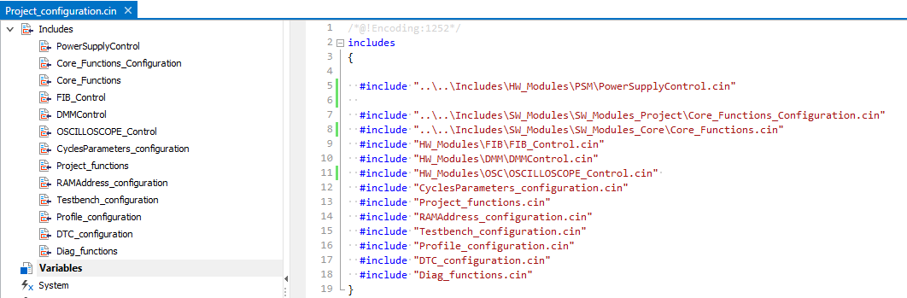
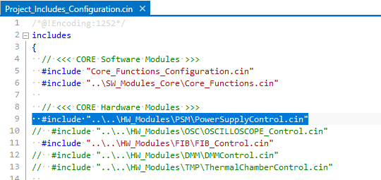
1. PowerSupplyControl.cin
If you wish to access PSM functionality through CAPL scripts, this must be included, otherwise skip this step.
E.g., for DAIMLER MMA:
Note: If the core structure is used, just uncomment the include line from “…\Includes\SW_Modules\SW_Modules_Project\Project_Includes_Configuration.cin”

Slide 4
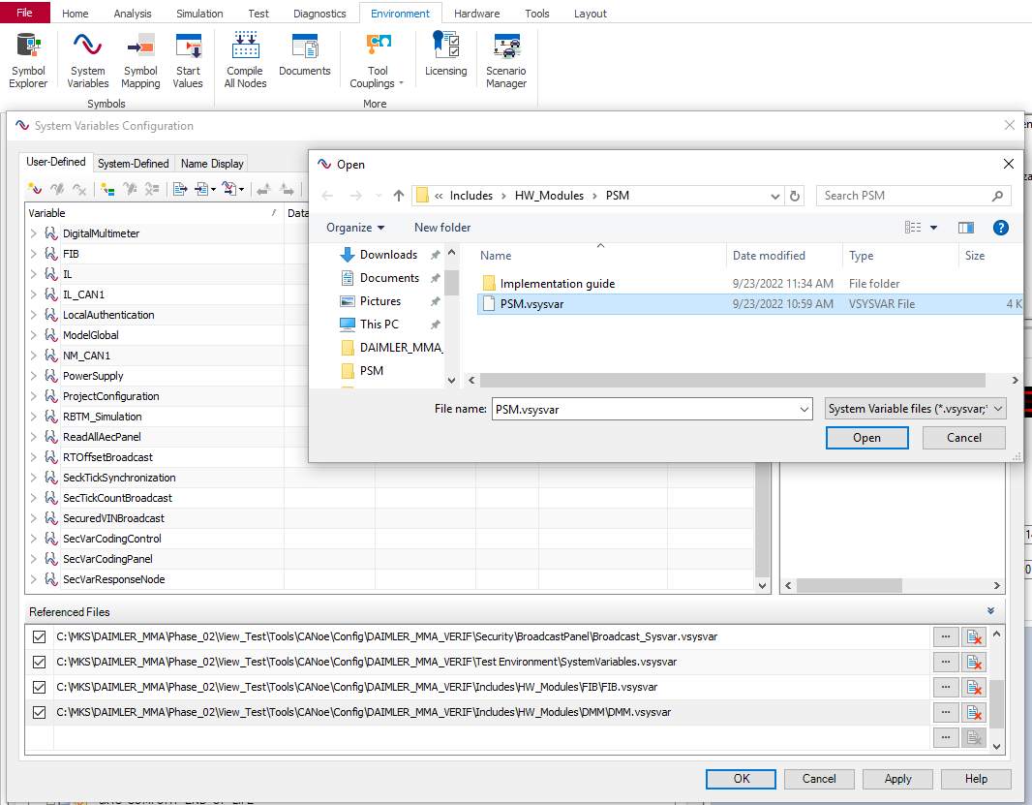
2.1 PSM.vsysvar
Import to CANoe configuration: (1) Environment → (2) System Variables → (3) Select File → (4 & 5) Open
1
2
4
5
3

Slide 5
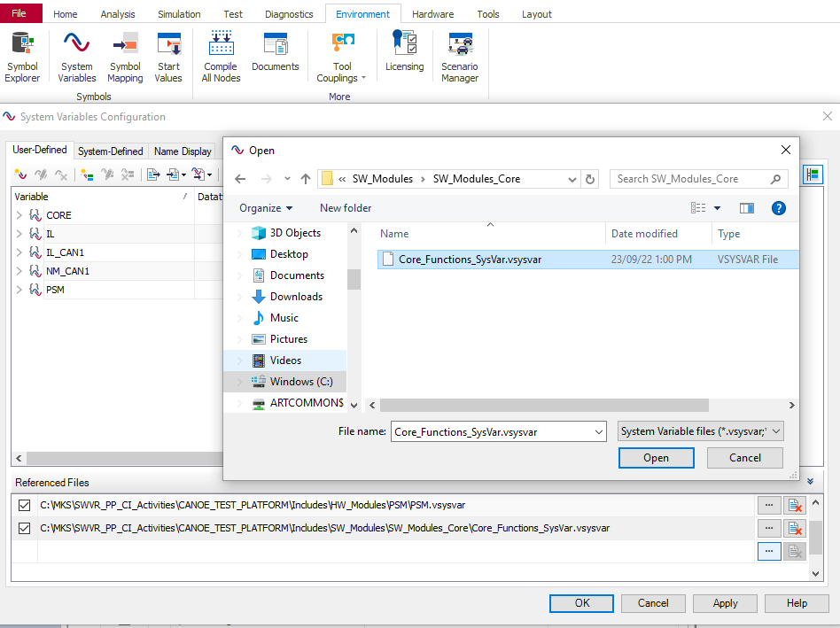
2.1 CORE_Functions_SysVar.vsysvar
Location: e:/MKSProjects/SWVR_PP_CI_Activities/CANOE_TEST_PLATFORM/Includes/SW_Modules/SW_Modules_Core
Import to CANoe configuration: (1) Environment → (2) System Variables → (3) Select File → (4 & 5) Open
1
2
4
5
3

Slide 6
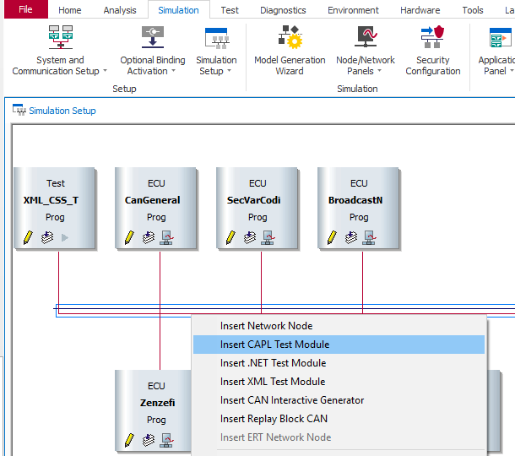
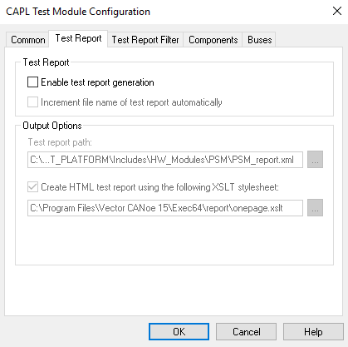
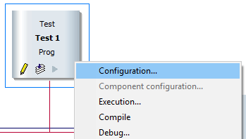
3. PSM.can
Add to CANoe:
(1) Simulation → (2) Simulation Setup → (3) Right click anywhere on the BUS → Insert CAPL test module
Right click the new generated test module → (4) Configuration → (5) Test report → (6) Uncheck ‘Enable test report generation’
1
2
4
5
6
3

Slide 7
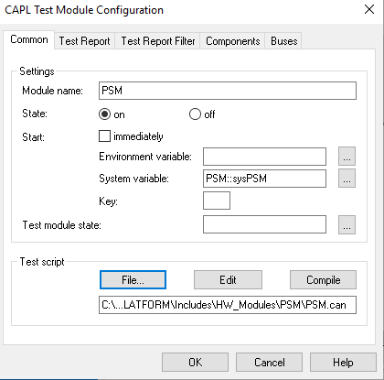
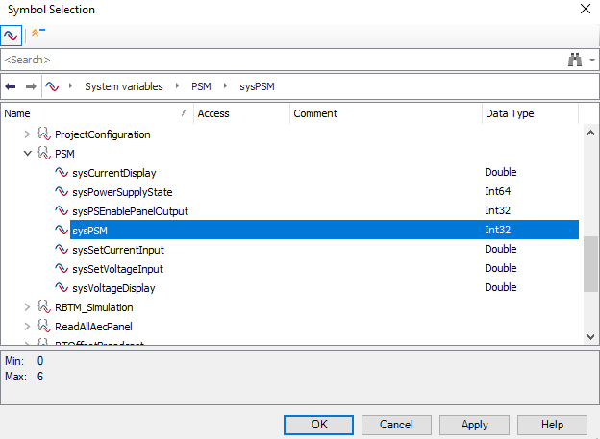
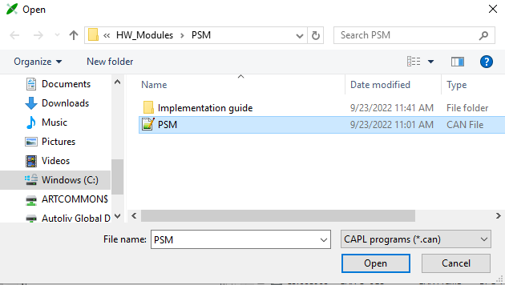
Common -> (7) Rename the module → (8) Attach test module trigger: sysPSM → (9) File… -> Attach test script: PSM.can
7
8
9

Slide 8
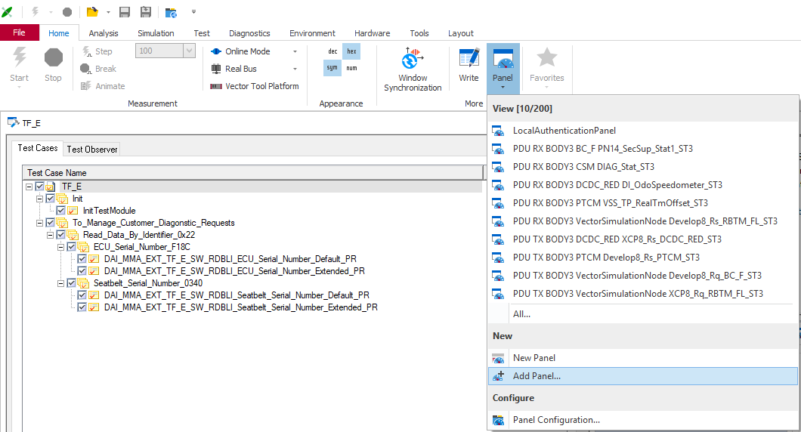
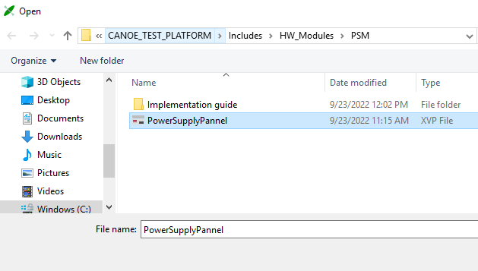
4. PowerSupplyPannel.xvp
Import to CANoe configuration: Home → Panel → Add Panel…
1
2
4
3

Slide 9
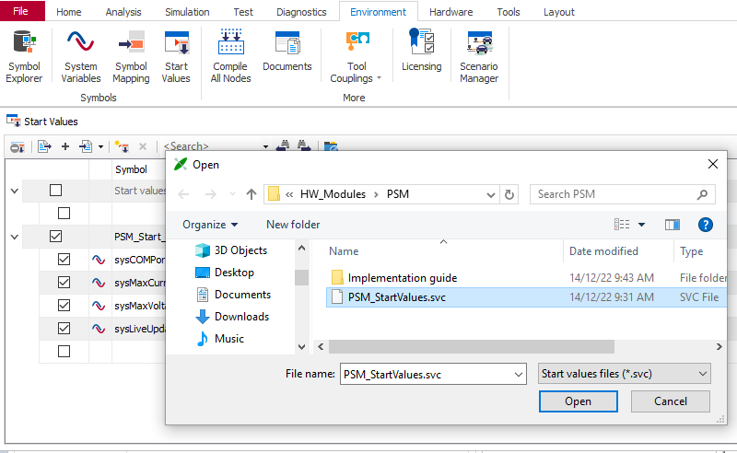
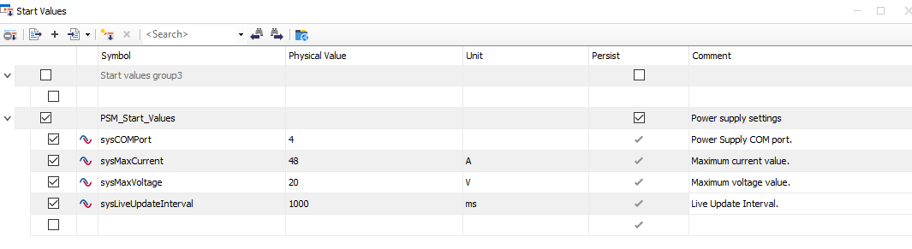
4. PSM_StartValues.svc
Import to CANoe configuration: (1) Environment→ (2) Start Values→ (3) Append (+) → (4) Open PSM_StartValues.svc
IMPORTANT: Save the CANoe configuration before starting the simulation.
The panel is configured through the ‘Start Values’ panel. Configuration is done before simulation start:
1
2
3
4

Slide 10

Saving More Lives

